Slide 1
Traffic Prediction
Using Deep Learning & CNN

Slide 2
Contents
Introduction
Objectives
Dataset Overview
Dataset Features
Model Selection – CNN
Model Architecture
Multi-Output Approach
Training Process
Results & Performance
Streamlit App Demo
Challenges Faced
Future Enhancements
Applications
Conclusion and Q&A

Slide 3
Introduction
Growing Challenge
Urban traffic congestion impacts daily life.
Empowering Decisions
Accurate predictions enable proactive management.
Improved Mobility
Informed decisions lead to smoother traffic.
leads to significant delays.
Fuel consumption rises. Environmental pollution increases too.
City planners optimize routes.
Overall urban mobility improves.
Commuters choose better times.

Slide 4
Objectives
Problem with Current Systems
Lack predictive capabilities.
Difficult to proactively manage.
Model Development Goal
Robust machine learning model.
Accurate congestion prediction.
Multi-Output Predictions
Forecast congestion levels.
Predict next total vehicles.
Ineffective for mitigation.
Uses real-world traffic data.
Identify main vehicle type.

Slide 5
Dataset Overview
Dataset Name: TrafficTwoMonth(Kaggle)
Time Coverage: Multi-day to multi-month
Interval: 15-minute timestamps
Records: 5952 entries

Slide 6
Dataset Features
Time & Date
Exact observation time. Includes date and day of the week.
Vehicle counts
Traffic Situation
Labeled congestion levels. Examples: low, normal, heavy, high.
Car, bike, bus, and truck counts. Total count aggregates all types.

Slide 7
Model Selection - CNN
Traditional ML Limitations
Requires extensive feature engineering.
Less effective with temporal dependencies.
May not capture complex patterns.
CNN Advantages
Processes sequential data effectively.
Learns patterns across timesteps.
Adapts to multiple outputs.

Slide 8
Model Architecture
Input Layer
Conv1D & MaxPooling1D
Flatten
Dense & Dropout
Multi-Output Heads
Initial data input with shape (3, 5).
Convolutional layer (32 filters, kernel=2, ReLU) followed by max pooling.
Transforms pooled feature maps into a 1D vector.
Fully connected layer (64/128 units, ReLU) with 0.3 dropout.
Congestion Level (Softmax), Total Vehicles (Linear), Main Vehicle (Softmax), Time Until Change (ReLU)

Slide 9
Multi-output Approach
Congestion levels
Main Vehicle Type
Next Vehicle Counts
Low, Normal, Heavy, High.
Car, Bus, Bike, Truck

Slide 10
Training Process
Data Split
1
80-20 training/testing split. Ensures reliable performance on unseen data.
Model Training
2
Adam optimizer used. Specific loss functions per output type.
Validation & Dropout
3
20% validation for monitoring overfitting.
Epochs: 30, Batch Size: 32.
Dropout rate of 0.3 for generalization.

Slide 11
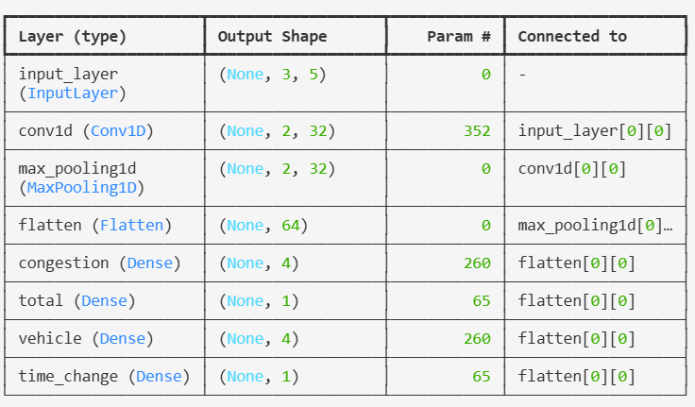
Results & Outputs

Slide 12
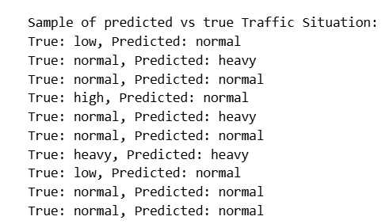
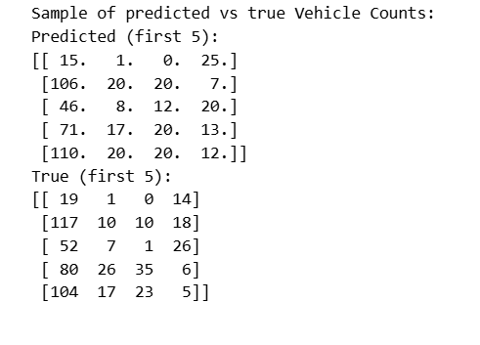
Results
The accuracy of the model is 71.33%

Slide 13
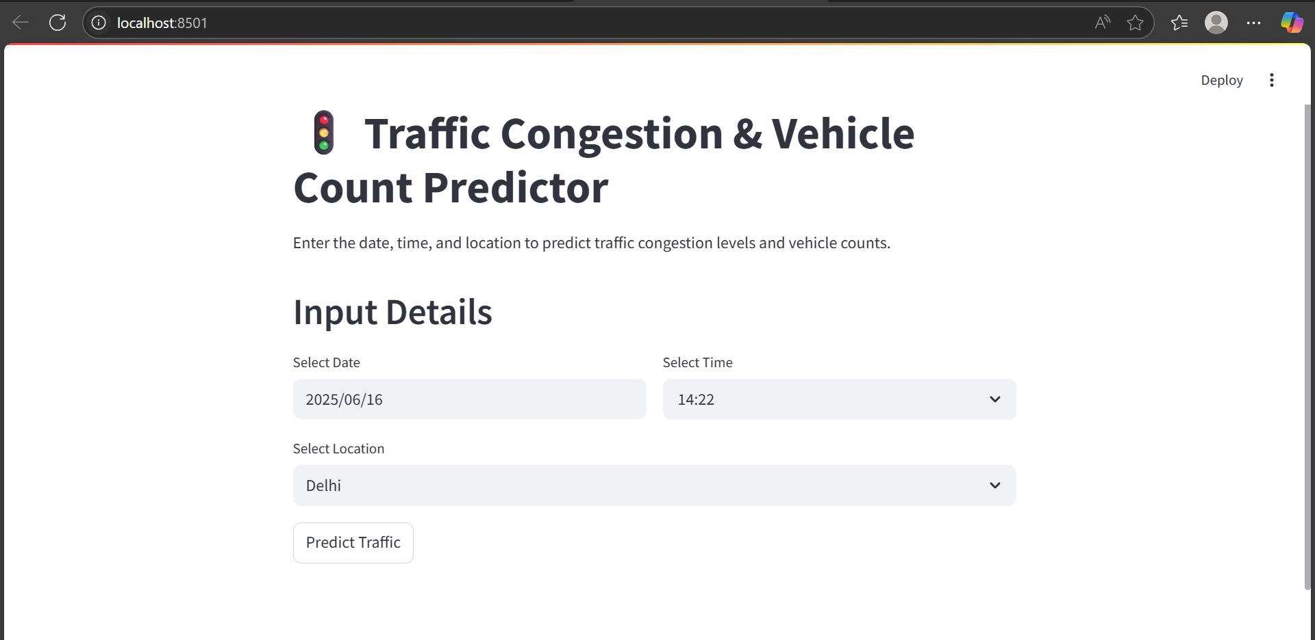
Streamlit App Demonstration

Slide 14
Challenges Faced
Multiple outputs
classifying traffic congestion levels (a categorical output) and regressing individual vehicle counts (multiple continuous outputs for cars, bikes, buses, and trucks).
One head dedicated to congestion classification (ending with a softmax activation).
Another head dedicated to vehicle count regression (ending with relu activations to ensure non-negative counts).

Slide 15
Systematically tuned the model's hyperparameters (e.g., number of layers, neurons, dropout rates) to find a configuration that improved overall model performance across both prediction tasks without significantly compromising any single output.
Balancing Accuracies among different outputs
Achieving balanced accuracy across multiple outputs is challenging. These outputs include congestion, total vehicles, and main vehicle type.

Slide 16
Conclusion and Q&A
Robust Model Developed
CNN model predicts traffic and related metrics effectively. It leverages real-world data for high reliability.
Multi-Output Predictions
The model accurately forecasts congestion, vehicle counts, and main vehicle types. It also predicts time until change.
User-friendly deployment
The interactive Streamlit app facilitates easy traffic forecasting. It provides practical insights for users.

Slide 17
Thank You
----------------------------------------------------------------------------------------------------------------------------

